Slide 1


Covid Positive Analysis
The world has seen nothing like this disease before. So we are getting into the numbers to understand its effect on racial and ethnic groups.

Slide 2
Questions to Answer
1.a) Which SE state had the most positive cases?
1. b) Which SE state had the least positive cases?
2. Which SE state had the lowest/highest survival rate?
3. Who had the least/most deaths from testing positive?
4. Which state had the highest recorded covid positive test?
5. What is the total covid hospital count?
6. What percentage of the state's covid cases is reported as Hospital Cases?

Slide 3
Data Cleaning
Drop Empty Columns
Extract subset of Data
Review another data and make comparisons
Ignore Values below Zero for Charts

Slide 4
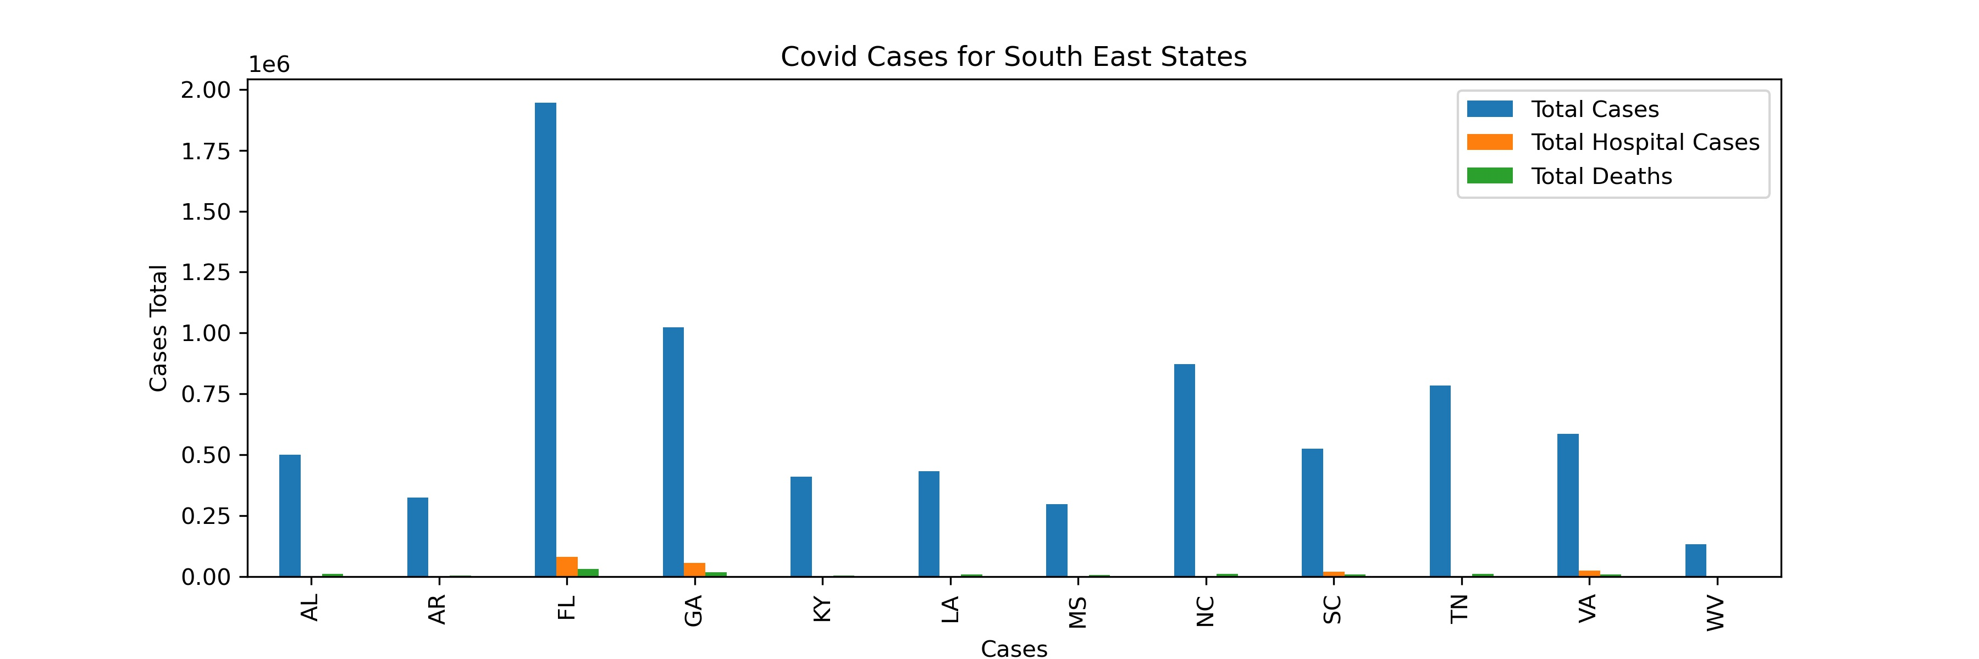
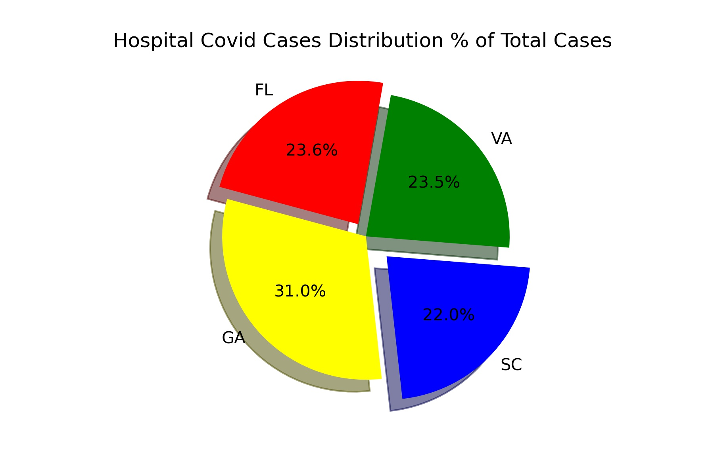
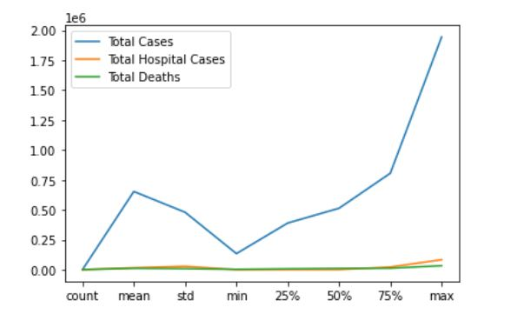
South East States Covid Analysis Dashboard

Slide 5
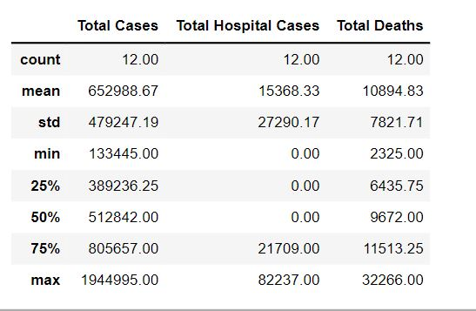
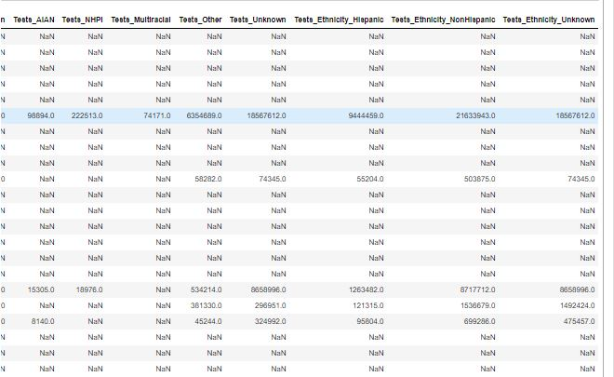
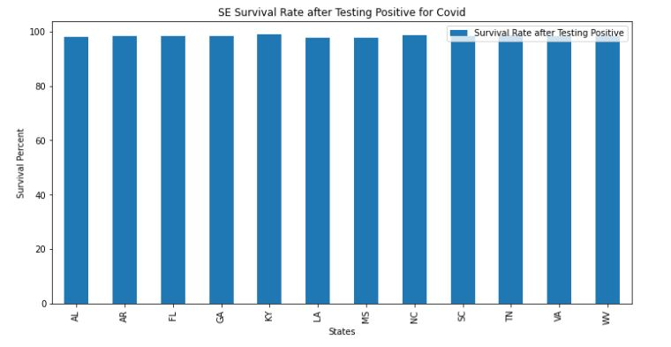
South East States Covid Analysis Dashboard

Slide 6
Data Analysis
Assumptions:
1. Total amount of deaths will be black
2. Dataset will adequately provide the data needed to answer questions
3. Enough time is available to review all questions about the dataset.
Observations and Review:
Another data set and make comparisons.
Conclusion:
Not enough time is available to completely revamp dataset for new calculations.
Data did not provide enough data for a well-rounded assessment at conclusion

